Slide 1
Multi-Threading I
Andrew Hu

Slide 2
Administrivia
Attendance is still http://tinyurl.com/uwigem/18sp/attendance/
Pacman projects due tonight
Looking for just a minimum viable product
If a significant amount of progress has been made by deadline, it may be extended

Slide 3
Project Updates
Current order of project ideas
DAWGMA Arduino Project
Chromastat overhaul
Video Game for outreach
Other options
Microfluidics project (whatever shape this takes on)
CS-Research with comp bio labs

Slide 4
What is multi-threading?
More cores?
More Chrome thingies on Task Manager?
(Seriously what’s up with that???)
More windows on screen at once?

Slide 5
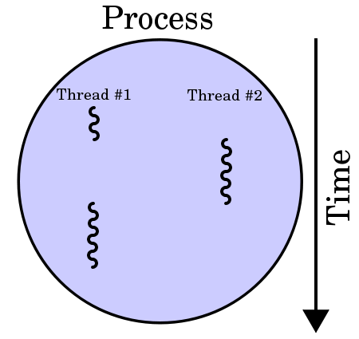
Multi-Threading w/o Multiple Cores
Multi-threading predates multiple core CPUs
A way to force the OS to give “equal” time to different parts of the same program
Not actually running at the same time, just fast switching between threads

Slide 6
Motivating Example: Word Processing
We need to handle keyboard input, plus the rest of the program logic
What happens when we do a grammar check? What if we keep typing?
Note, most input libraries fix this problem, but in designing systems we can’t assume things will just work
void main() {
while (true) { // Look for keyboard input by waiting until
// a key is pressed
char input = nextKeyPress();
// Write it to the file
file.write(input);
// If it’s the end of a sentence, grammar
// check the last sentence
if (input == ‘.’) {
// This takes a really long time!
grammarCheck(file);
}
}
}

Slide 7
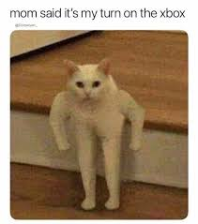





Operating System
Speed gains not just thanks to more cores
Operating system allows
Creating different “threads” for the same program
Controlling threads across different cores
Preventing threads from writing to the same data at once
Scheduling which threads get time on the CPU

Slide 8
Software Interface
What does a multi-threaded program even look like?
//Program start
//Create data to tell your new //thread what to do
int message = 42;
//Create a new child thread
//with this message
runChild(message);
print(“Hello from the parent”);

Slide 9
Software Interface
What does a multi-threaded program even look like?
//Program start
//Create data to tell your new //thread what to do
int message = 42;
//Create a new child thread
//with this message
runChild(message);
print(“Hello from the parent”);
/*DOESN’T START UP HERE*/
//Goes from fork();
print(“Hello from the child: ” + message);

Slide 10
What gets printed?
Let’s find out!
Code is here: http://tinyurl.com/uwigem/18sp/documents/multithread1.zip
Compile from command line with
javac Parent.java
java Parent
What did it print out?
0
100
Hello from the child: 42
200
300
400
500
Hello from the parent

Slide 11
Break it down!
public class Parent {
public static void main(String[] args) {
// Create the message
int message = 42;
// Start the child thread
Child childThread = new Child(message);
childThread.start();
// Twiddle our thumbs
for (int i = 0; i < 5000; i++) {
if (i % 1000 == 0) System.out.println(i);
}
// Print from the parent
System.out.println("Hello from the parent");
}
public static class Child extends Thread { ... }
}
Load the thread with our message, and start it
Kill time while printing out some numbers
Print out the parent’s message

Slide 12
Break it down!
public class Parent {
public static void main(String[] args) { ... }
public static class Child extends Thread {
private int message;
public Child(int message) {
this.message = message;
}
/*THIS IS THE SPECIAL METHOD*/
public void run() {
// Print our message
System.out.println("Hello from the child: " + this.message);
}
}
}
Make the child thread class inherit from Thread
The run() method gets run when we call Thread.start()

Slide 13
Word Processing: Fixed
class GrammarChecker {
// Running in a separate thread
void run(int message) {
while (true) {
waitForMessage();
if (message == 1) {
checkGrammar(); }
}
}
void checkGrammar() {
// Do the grammar check
// ...
}
}
void main() {
createThread(GrammarChecker);
while (true) {
char input = nextKeyPress();
// Write it to the file
file.write(input);
if (input == ‘.’) {
sendMessage(grammarChecker, 1);
}
}
}

Slide 14
Multi-Threading Experiment
When is the child thread’s message printed, again?
What happens when we remove the for loop that wastes time?
What happens when we make the for loop much shorter?
0
100
Hello from the child: 42
200
300
400
500
Hello from the parent

Slide 15


Message Passing
class GrammarChecker {
// Running in a separate thread
void run(int message) {
while (true) {
waitForMessage();
if (message == 1) {
checkGrammar(); }
}
}
void checkGrammar() {
// Do the grammar check
// ...
}
}
void main() {
createThread(GrammarChecker);
while (true) {
char input = nextKeyPress();
// Write it to the file
file.write(input);
if (input == ‘.’) {
sendMessage(grammarChecker, 1);
}
}
}
Both threads already running, but they can communicate!

Slide 16
Message Passing Experiment
Code here: http://tinyurl.com/uwigem/18sp/documents/multithread1.zip
Creates two threads, and does work in both of them
Once the child thread is finished, it sends a message back

Slide 17
Parallelism vs Concurrency
Two words for using the same thing differently
Parallelism
Using multiple threads to do one operation faster
Concurrency
Using multiple threads to do different things at the same time

Slide 18
Test
Test
Hello, there!
int main() { // Code goes here
}

